Slide 1



Caml2Table
Dan Toft
@Tanddant
https://Dan-Toft.dk

Slide 2
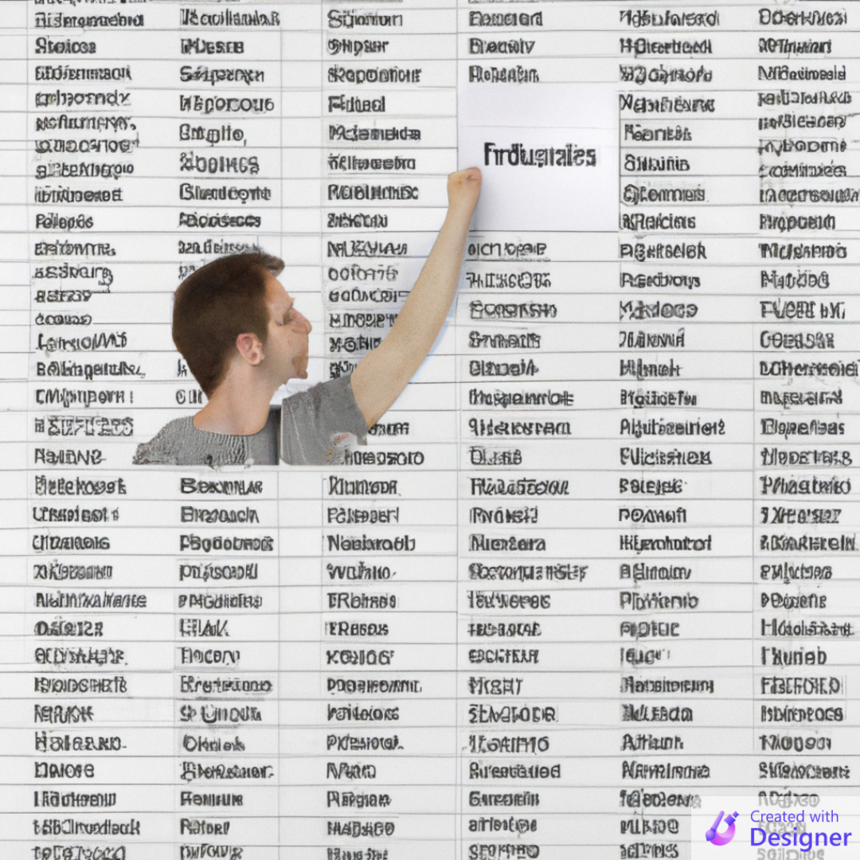
About this sample
Why did I make this sample
Training of a new employee
What is CAML – and when/why do we use it?
CAML vs. SP REST
PnPjs & PnP Reusable controls
A Quick way to go from zero to hero
React Context
Probably the best way to avoid prop drilling
Notes:
New employee – without CSOM/SharePoint experience
Quick way to visualize
Samples of SPFx app demonstrating most basic needs

Slide 3
Demo
Notes:
Filter
Connect-PnPOnline "https://2v8lc2.sharepoint.com/sites/TanddantTest" –Interactive
Set-PnPView -List "Onboarding tasks" -Identity "My pending tasks" -Values @{ViewQuery = "<Where><And><Membership Type='CurrentUserGroups'><FieldRef Name='Responsible' /></Membership><Neq><FieldRef Name='Status' /><Value Type='Choice'>Done</Value></Neq></And></Where>"}
CAML Current user is in group
<View>
<ViewFields>
<FieldRef Name="Title" />
<FieldRef Name="ResponsibleId" />
<FieldRef Name="Status" />
</ViewFields>
<Query>
<Where>
<Membership Type="CurrentUserGroups">
<FieldRef Name="Responsible" />
</Membership>
</Where>
</Query>
</View>
------
<View>
<ViewFields>
<FieldRef Name="Title" />
<FieldRef Name="ResponsibleId" />
<FieldRef Name="Status" />
</ViewFields>
<Query>
<Where>
<And>
<Membership Type="CurrentUserGroups">
<FieldRef Name="Responsible" />
</Membership>
<Neq>
<FieldRef Name="Status" />
<Value Type="Choice">Done</Value>
</Neq>
</And>
</Where>
</Query>
</View>

Slide 4
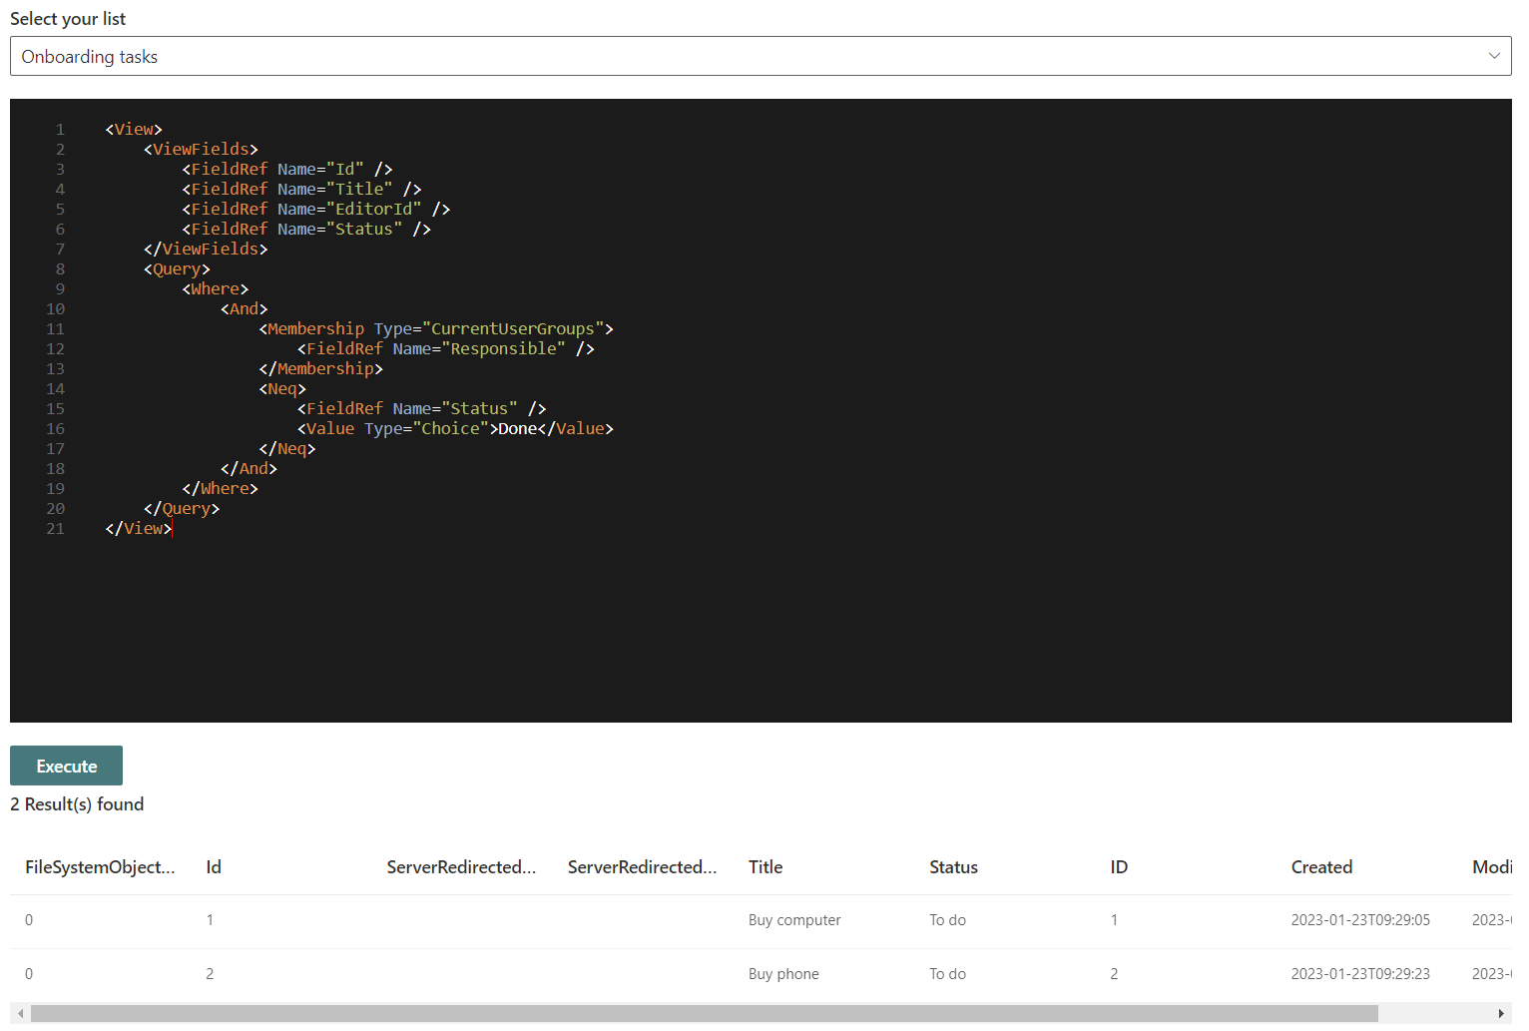

Slide 5
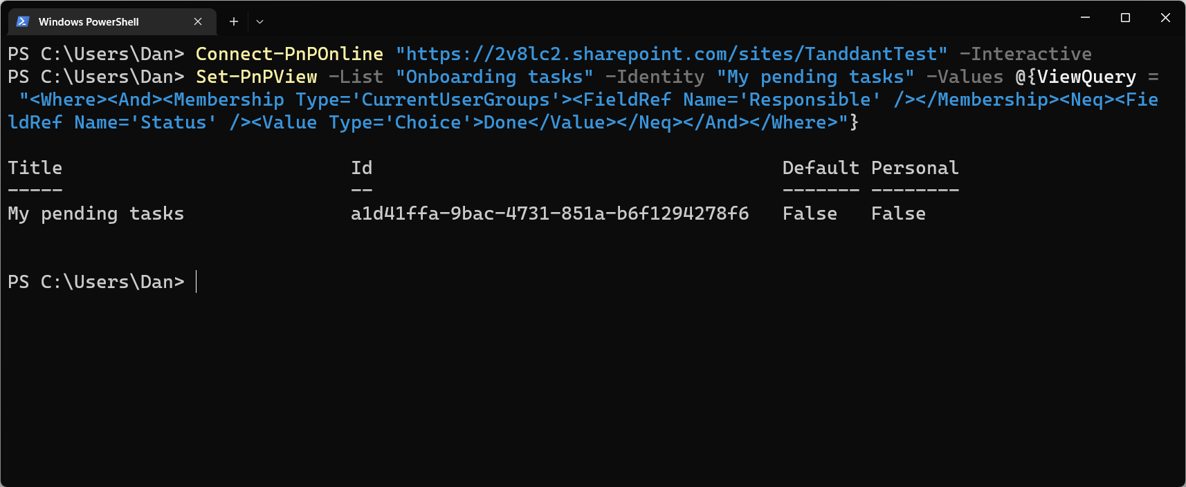
Use for views

Slide 6
Code

Slide 7
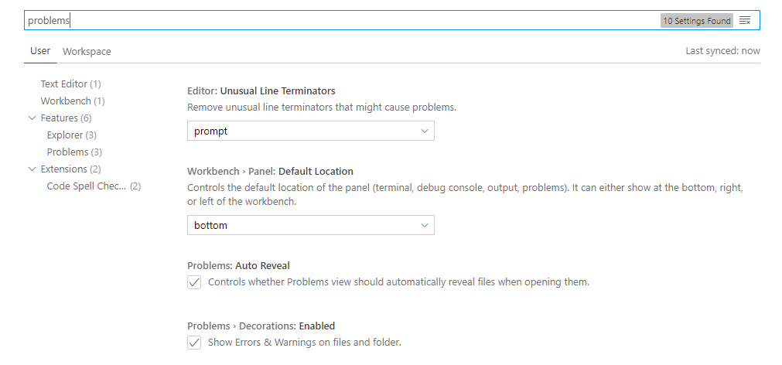
CODE SLIDES – READ ME
The code slides will automatically animate and morph if you keep the object names the same.
Example:
If the Code snippet image and the highlight rectangle in “Selection” pane is the same name for all slides, it will automatically morph and animate between slides.
The “Animation Morph Templates” section has examples of how this works.
For the next slides, please see the speaker notes for additional information

Slide 8
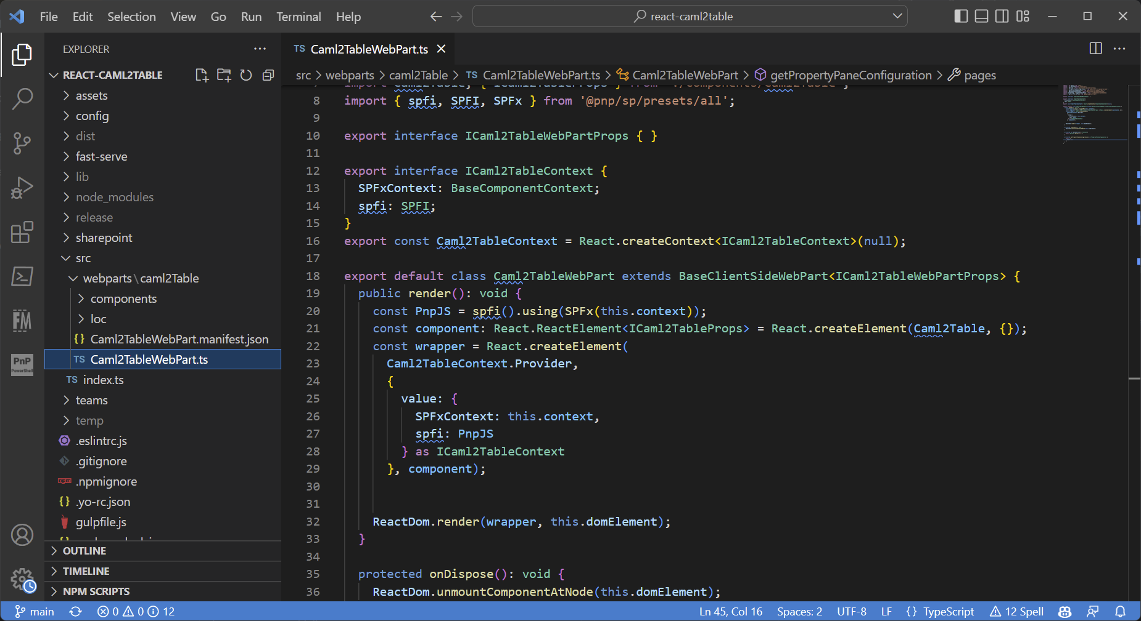
Caml2TableWebPart.ts
Notes:
Functional components

Slide 9
Caml2TableWebPart.ts
Notes:
Functional components

Slide 10
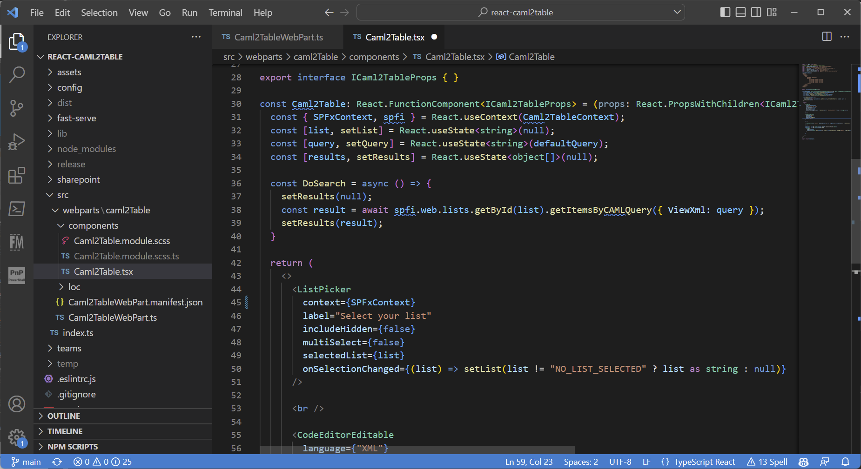
Caml2Table.tsx

Slide 11
Thank you!
react-caml2table:
https://github.com/pnp/sp-dev-fx-webparts/tree/main/samples/react-caml2table
CAML Query
https://learn.microsoft.com/sharepoint/dev/schema/collaborative-application-markup-language-caml-schemas
PnP Reusable controls
http://aka.ms/pnp-react-controls
@Tanddant
https://Dan-Toft.dk
Notes:
Dan

